Slide 1

History of Programming Languages
Machine languages
Assembly languages
High-level languages
  Procedure-oriented
  Object-oriented/Event-driven

Slide 2
OOP Terminology
OOP - object-oriented programming
  using an object-oriented language to create a program that contains one or more objects
OOD - object-oriented design
  the design methodology used to plan object-oriented programs
  divides a problem into one or more objects

Slide 3
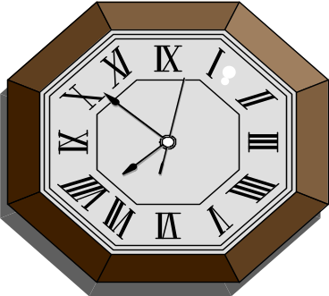


Object
Anything that can be seen or touched
Has attributes that describe the object
Has behaviors that the object can either perform or have performed on it

Slide 4

Class
Pattern or blueprint for creating an object, which is an instance of a class

Slide 5
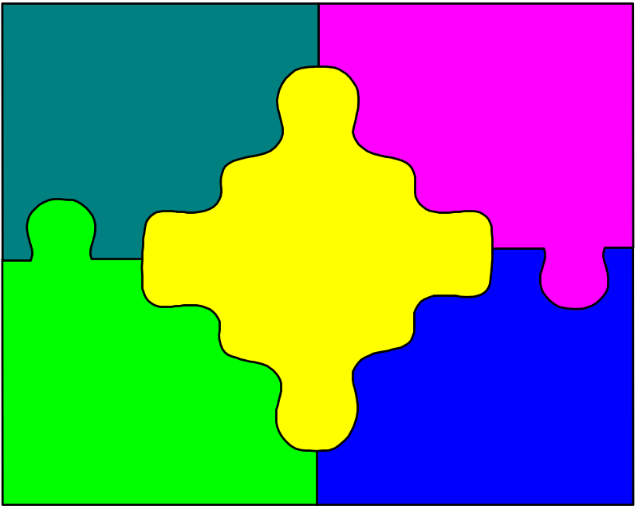
Encapsulation
To enclose in a capsule
Combining an object’s attributes and behaviors into one package—a class

Slide 6

Abstraction
Hiding the internal details of an object to prevent the user from making inadvertent changes to the object
Some attributes and behaviors are hidden, while others are exposed

Slide 7
Inheritance
Allows you to create one class from another class
The new class is called the derived class
The original class is called the base class

Slide 8

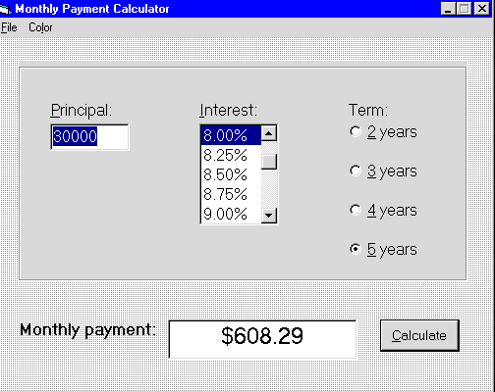
Monthly Payment Application

